Slide 1
How does the model works
Step 1
Stablish the decision matrix and normalizes it
Step 2
Step 4
Calculate the Gausian factor for each criterion
Step 5
Multiplying the Gaussian fator by the decision matrix
Step 6
Step 3
Calculate the Standart deviation of the alternatives for each criterion
Obtain the ranking
Calculate the average of the alternatives
SOURCE: IJAHP Article: Santos, Costa, Gomes/Multicriteria decision-making in the selection of warships: a new approach to the AHP method

Slide 2
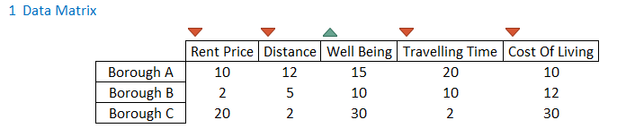

Slide 3
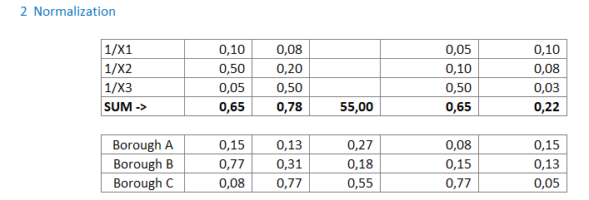

Slide 4
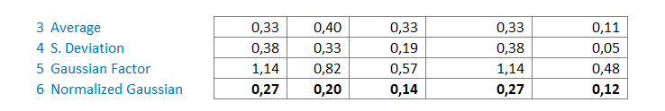

Slide 5
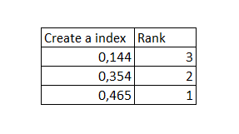

Slide 6
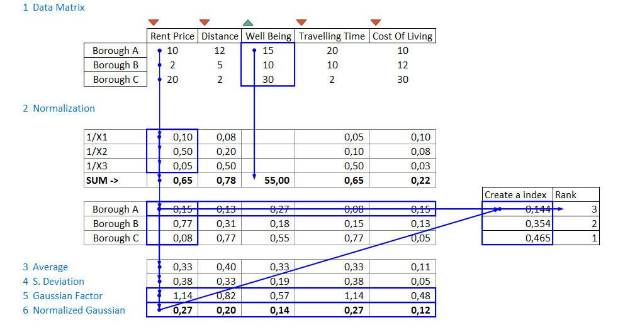

Slide 7
